Slide 1
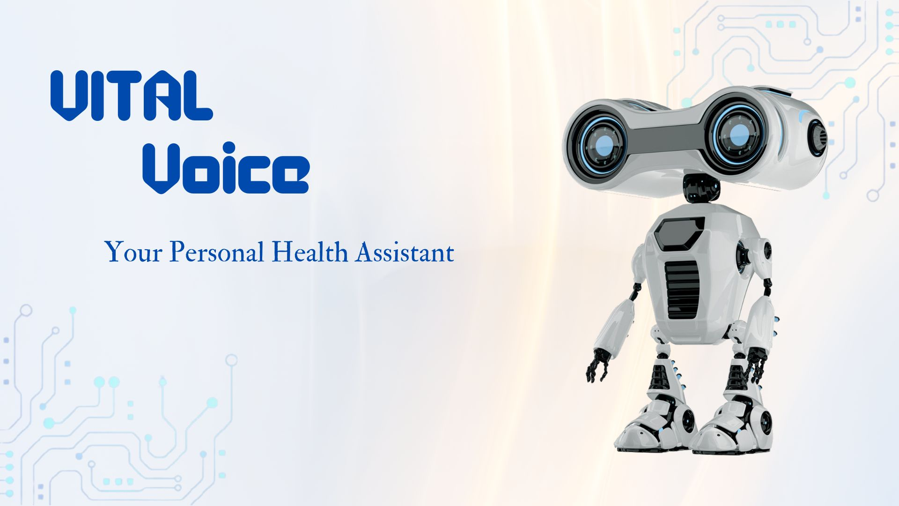

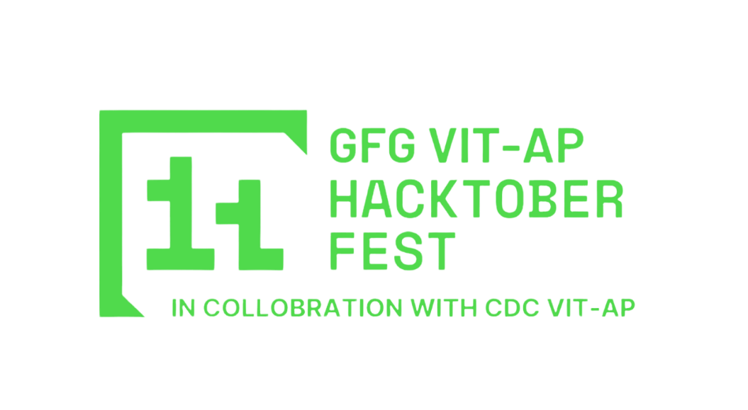
(Zethnos)

Slide 2
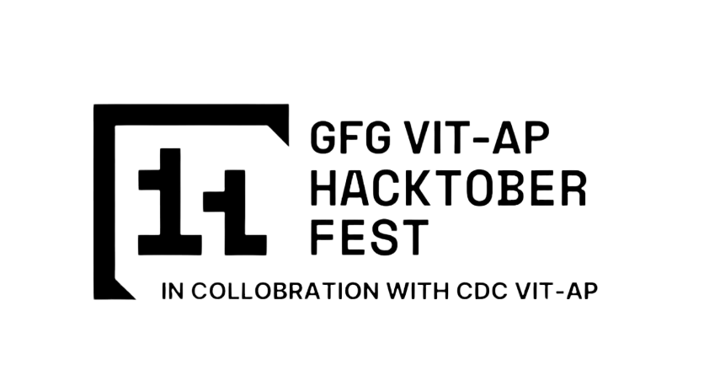
NEED FOR VITAL VOICE
Internet has been the one stop solution for most of our problems for the past few decades. However, it has been primarily unsuccessful when it comes to the field of healthcare.
Vital Voice comes in at this point. We have inculcated a large database that diagnoses and suggests remedies based on the symptoms faced by the user.
For example, when a common man goes up on the web, every minor inconvenience amounts to cancer. We at Vital Voice aim to bypass this issue and get the underserved cheap and accurate solution.
Vital Voice will be a free and open source chatbot for everyone to access.

Slide 3
TECHNICAL ARCHITECTURE
Tech stack
Frontend Technologies: Python GUI, JS
Backend Technologies:Python, Java
Database: MySQL
Other Tools/Services:AWS, Git

Slide 4
SCALABILITY AND FUTURE SCOPE
Vital Voice will be working on distributed servers while a portion of the database that comes in handy on a daily basis will be preinstalled on the user’s device along with the chatbot.
Since the AWS Cloud server is renowned for its server rental services and its widespread use, it will come in handy for the database storage and quicker response time.
Along with the suitable remedies, we will also be providing a list of available doctors in the vicinity that would be helpful for the treatment procedure.

Slide 5
FEASIBILITY
The main issue arising would be to get verified response from authentic doctors to set up the entire database.
We would start with local doctors and make up a minor database that would then be moved to renowned doctors to update the database based on their input. This would provide an efficient and accurate database.

Slide 6
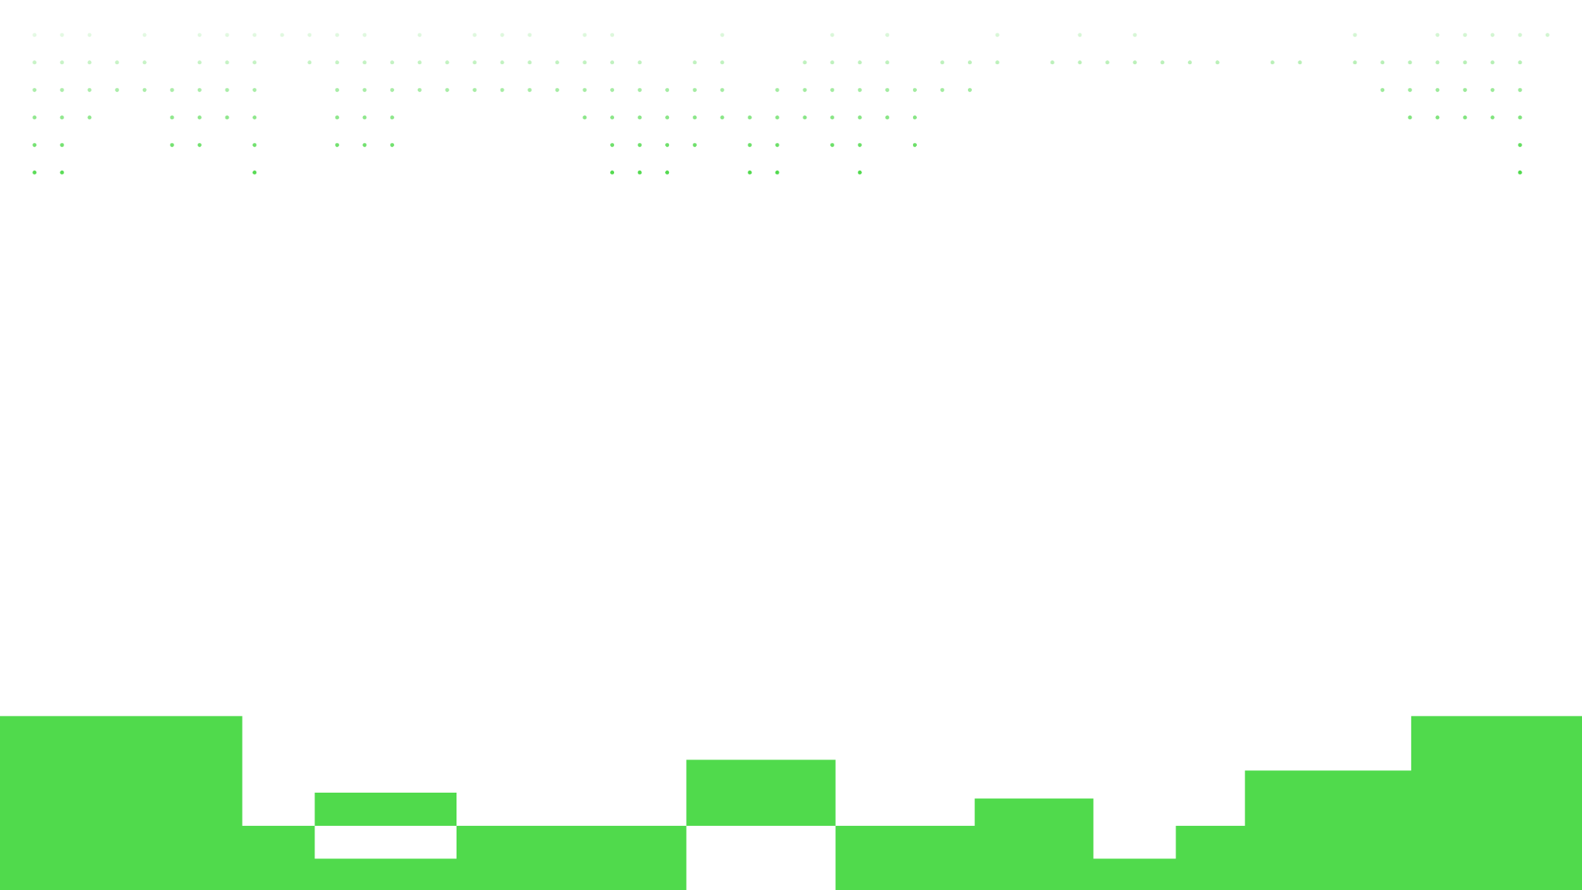
>Team Details

Slide 7
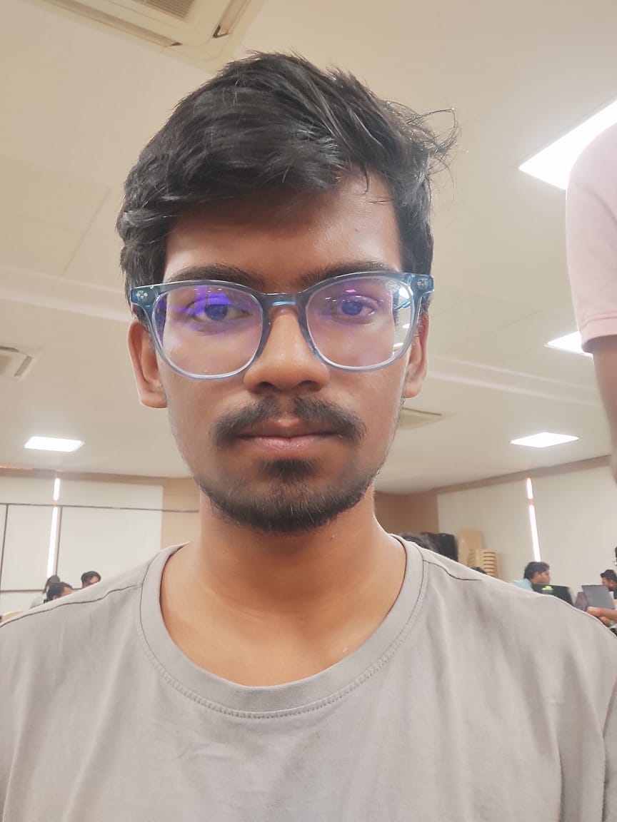
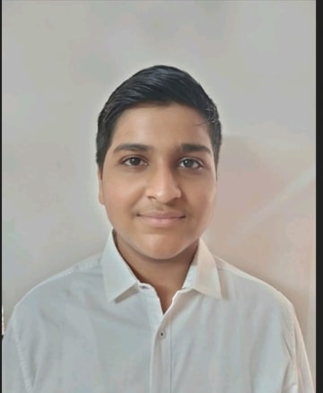

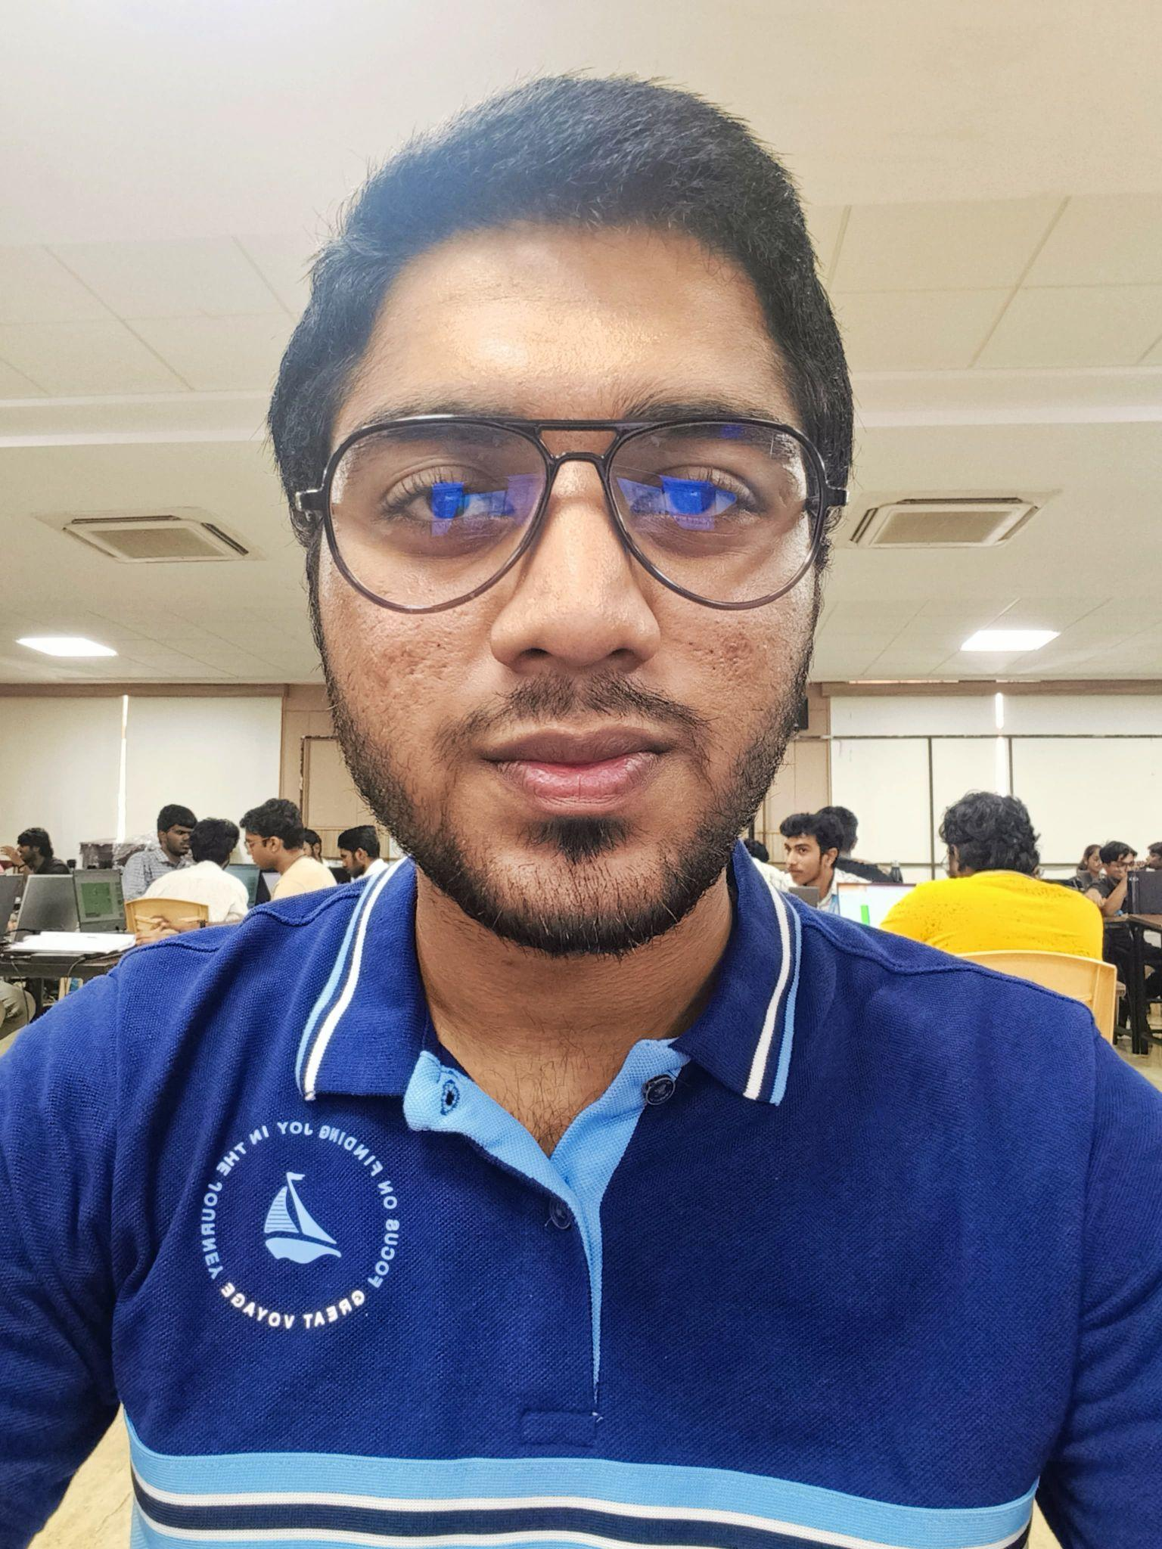
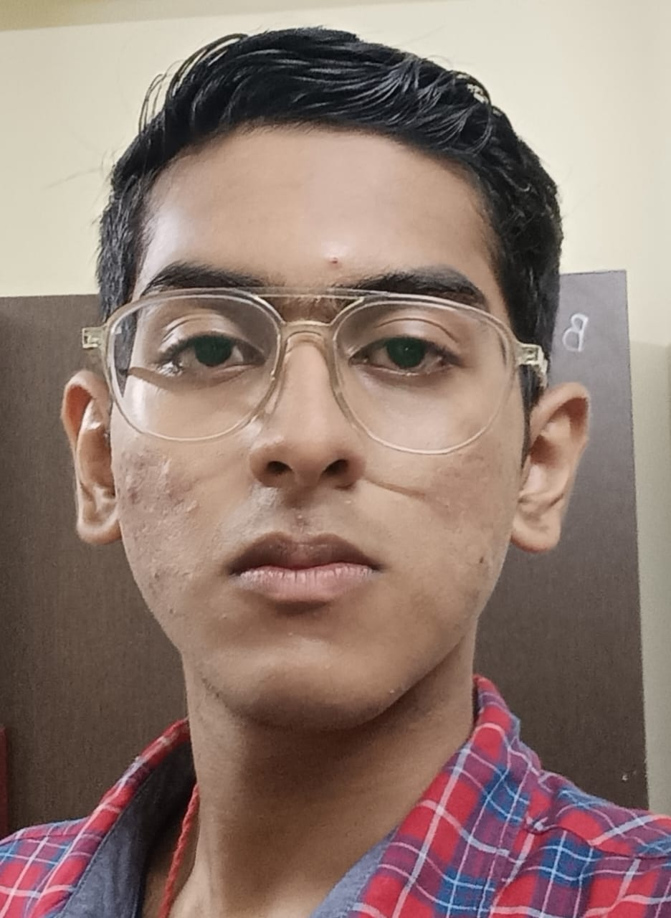

Ankit Sengupta
Varun Agarwal
Programmer
(Team Leader)
Programmer
Harshit Joshi
Sreyosh Majumder
Designer
Programmer

Slide 8

Thanks for Joining

